Slide 1


RANSOMWARE
ATTACK

Slide 2

AGENDA
#
Title
Slide
1
Introduction
3
2
Ransomware
9
3
How That Is Work
12
4
Challenge
17
5
Key Strategies
32
6
Incident Response Plan
35
7
Success Story
38
7
Conclusion
40
7
Q&A
42

Slide 3
INTRODUCTION

Slide 4

WHAT IS A CYBERATTACK?
An attempt to compromise the security of digital systems.
Targets include individuals, organizations, and governments.
Increasing in both frequency and complexity.

Slide 5
PURPOSE OF CYBERATTACKS
FINANCIAL GAIN (E.G., THEFT, RANSOM).
ESPIONAGE (E.G., STEALING SENSITIVE DATA).
DISRUPTION (E.G., DENIAL OF SERVICE, INFRASTRUCTURE ATTACKS).

Slide 6
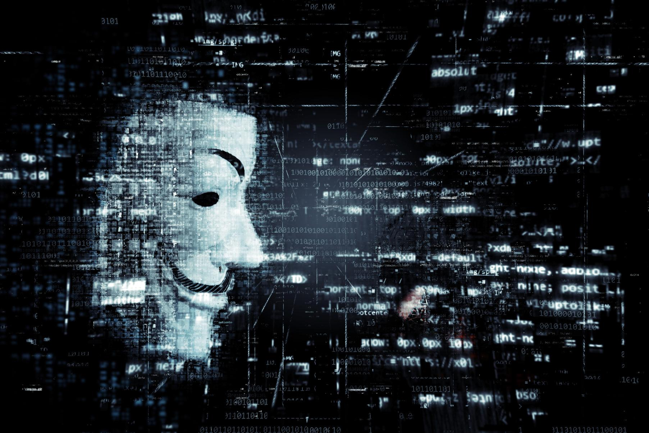
TYPES OF CYBERATTACKS
1. Malware: Malicious software that disrupts or
damages systems.
2. Phishing: Fraudulent attempts to steal sensitive
information.
3. Denial of Service (DoS/DDoS): Overloading
systems to make them unavailable.
4. Man-in-the-Middle (MitM) Attacks: Intercepting
communication between two parties.
5. SQL Injection: Exploiting vulnerabilities in
databases.

Slide 7
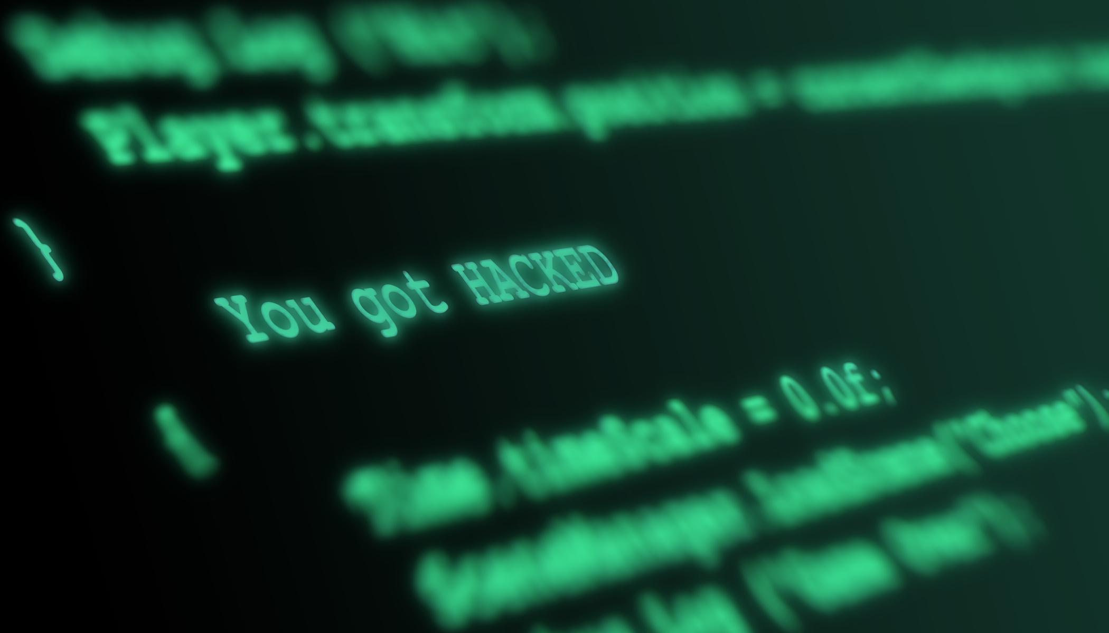
WHY CYBERATTACKS ARE A MAJOR CONCERN ?
Economic Impact: Loss of billions globally through data breaches and ransomware payments.
Operational Disruption: Downtime caused by attacks can cripple businesses.
Reputation Damage: Erosion of trust when companies cannot protect customer data.
Legal and Compliance Risks: Fines and penalties under regulations like GDPR, HIPAA

Slide 8
CYBERATTACK TRENDS
Increasing Sophistication: Hackers are using more complex methods (AI, automation).
Rise of State-Sponsored Attacks: Nation-states targeting critical infrastructure.
Targeting of Remote Work: Weak security in home networks is a growing attack surface.

Slide 9
RANSOMWARE

Slide 10
WHAT IS RANSOMWARE?
A form of malware that encrypts the victim's data.
Attackers demand payment (usually in cryptocurrency) to restore access.
One of the fastest-growing and most destructive forms of cyberattacks.

Slide 11

WHY RANSOMWARE IS UNIQUE
Directly affects the availability of data.
Puts pressure on victims to act quickly.
Usually paired with threats of data leakage (double extortion).

Slide 12
HOW THAT IS
WORKS

Slide 13
HOW RANSOMWARE WORKS
INFECTION
ENCRYPTION
RANSOM
DEMAND
PAYMENT OR RECOVERY
Via phishing emails, malicious attachments, or exploiting system vulnerabilities.
Files on the victim's system are encrypted and made inaccessible.
A message appears demanding payment to decrypt files.
Victims may either pay the ransom or attempt recovery through backups.

Slide 14
REAL-WORLD IMPACT OF RANSOMWARE
Example 1: Colonial Pipeline (2021)
A major U.S. fuel pipeline was forced to shut down due to a ransomware attack, leading to fuel shortages.
Example 2: WannaCry (2017)
Global ransomware attack impacting over 200,000 computers, particularly affecting healthcare services.
Financial Impact:
Estimated losses in the billions from ransom payments, recovery costs, and business disruption.

Slide 15
CURRENT APPROACHES TO DEFEND AGAINST RANSOMWARE
1. Traditional Security Measures
Antivirus, firewalls, and basic intrusion detection systems.
Regular patching of software to close vulnerabilities.
2. Backup Systems
Regular backups help organizations restore data in case of a ransomware attack.
3. Employee Training
Phishing awareness programs to prevent malware from entering through human error.

Slide 16
WHY CURRENT DEFENSES ARE INSUFFICIENT
Sophisticated Attack Techniques:
Attackers use advanced tactics, such as exploiting zero-day vulnerabilities.
Human Error:
Employees still fall victim to phishing attacks, providing attackers an easy entry point.
Inadequate Response Plans:
Many organizations lack proper incident response plans, leading to delays in containment and recovery.
Lack of Awareness:
Small and medium businesses often believe they are not targets, making them underprepared for ransomware.

Slide 17
CHALLENGE

Slide 18
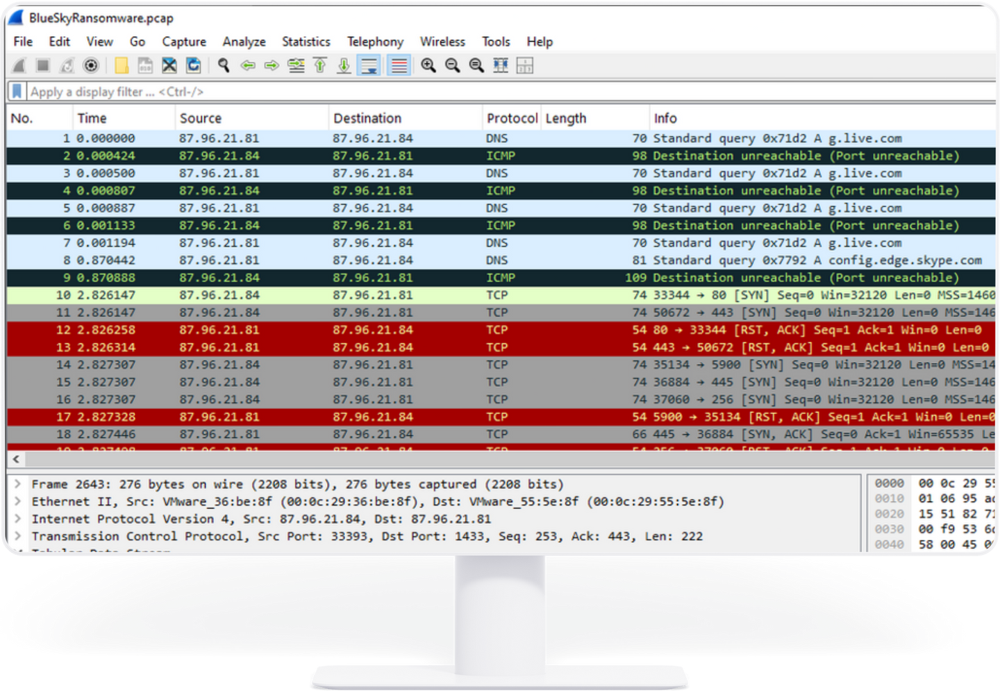
IDENTIFY THE ATTACKER

Slide 19
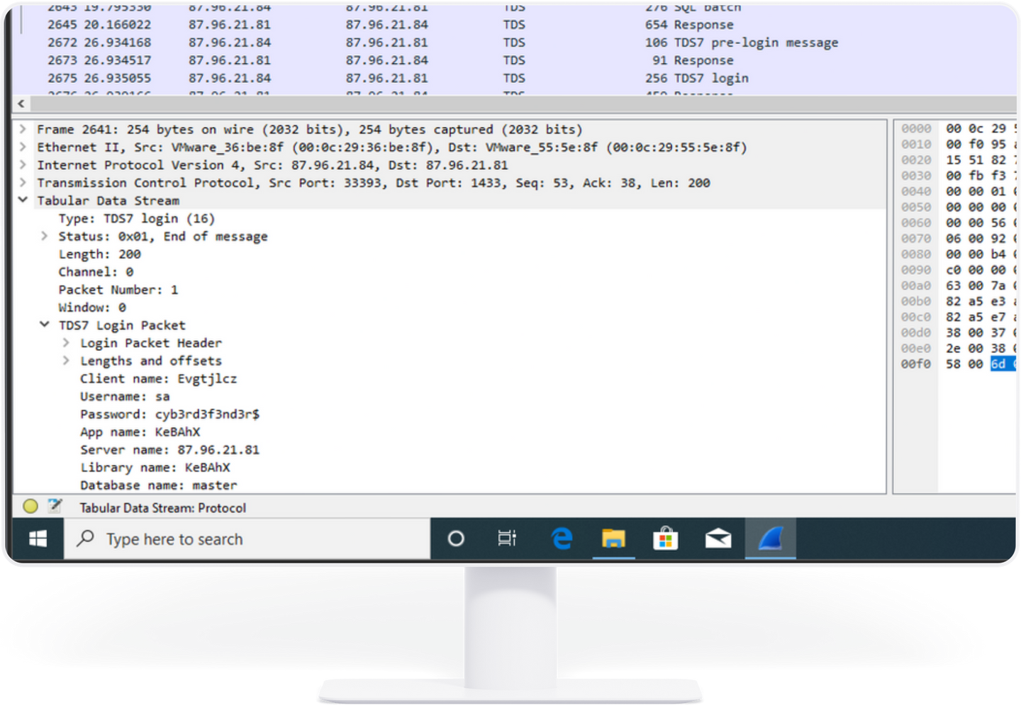
THE ATTACKER KNOWS SOME INFO ABOUT THE HOST

Slide 20
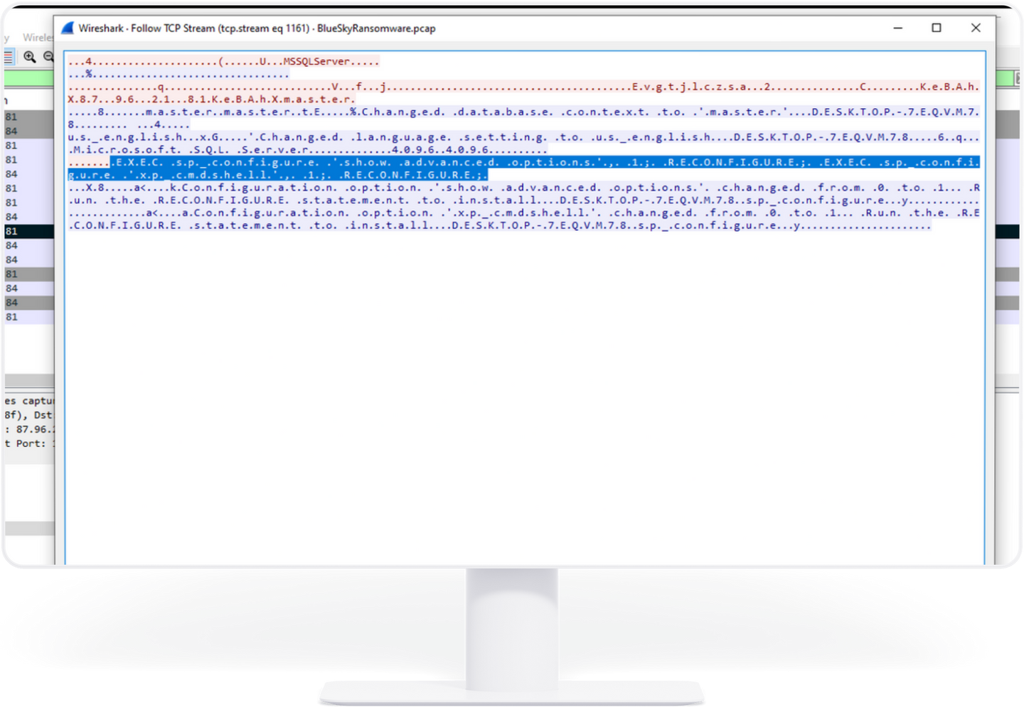
THE ATTACKER FACILITATES LATERAL MOVEMENT

Slide 21
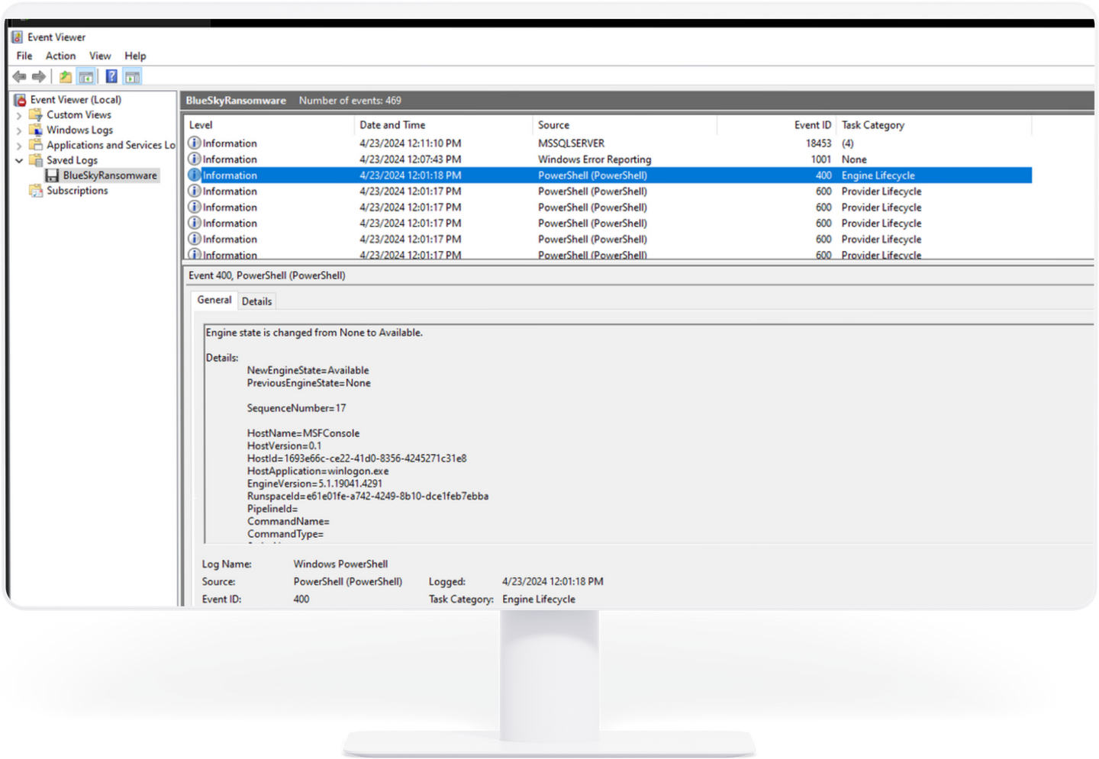
THE ATTACKER GAINS ADMINISTRATIVE PRIVILEGES

Slide 22
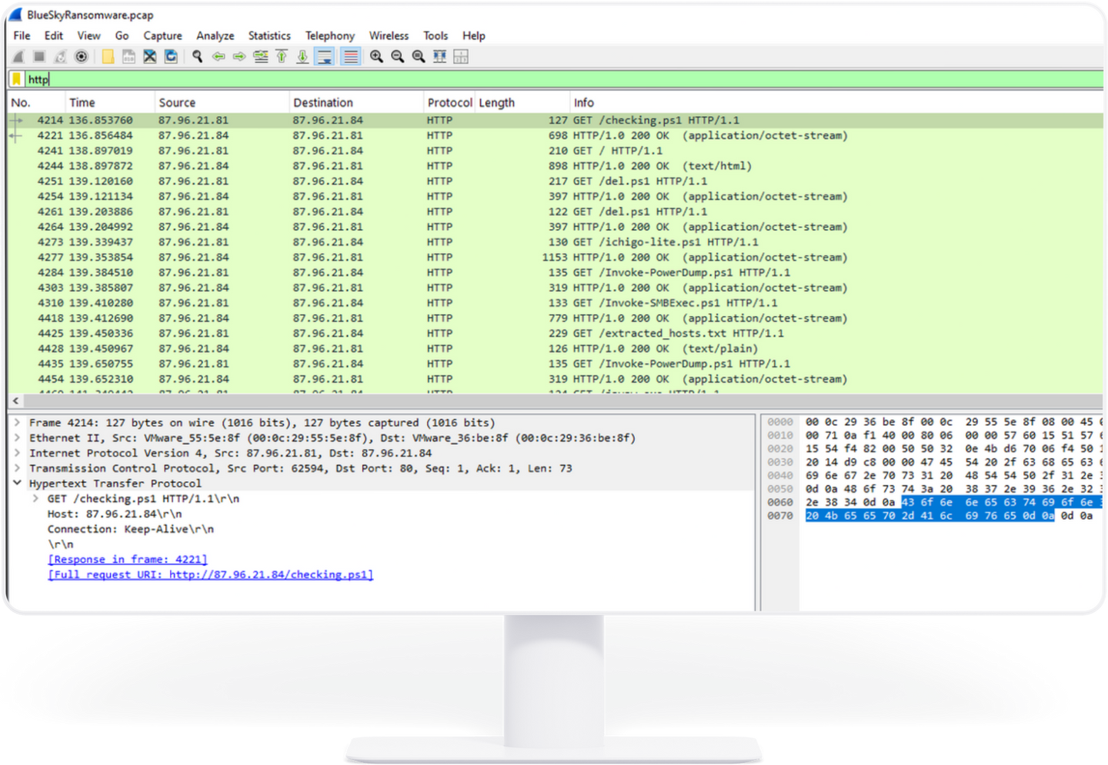
THE ATTACKER ATTEMPTED TO DOWNLOAD A FILE

Slide 23
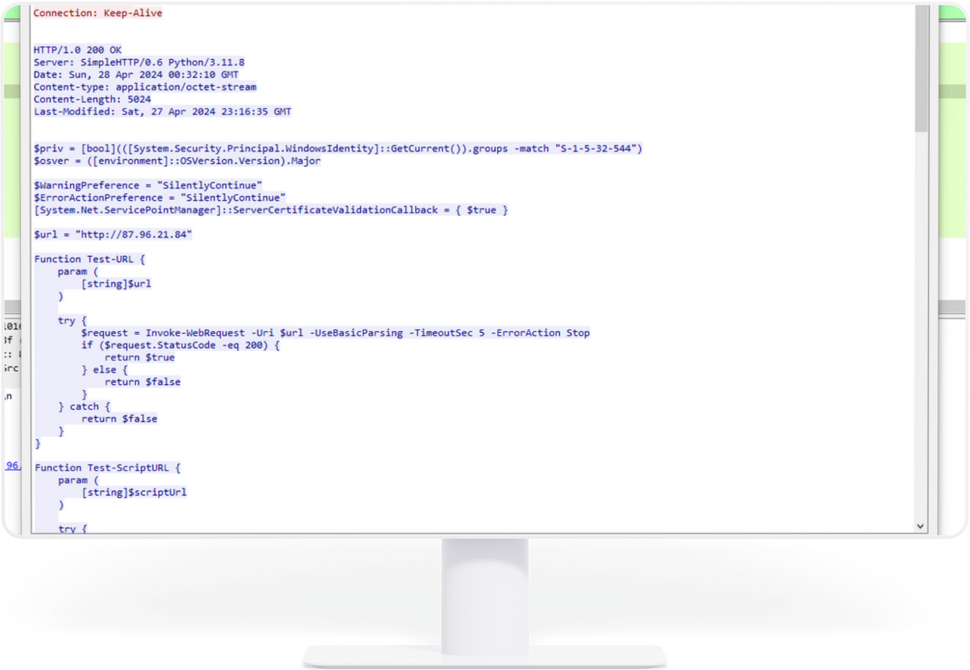
THE ATTACKER KNOWS SID ABOUT THE HOST

Slide 24
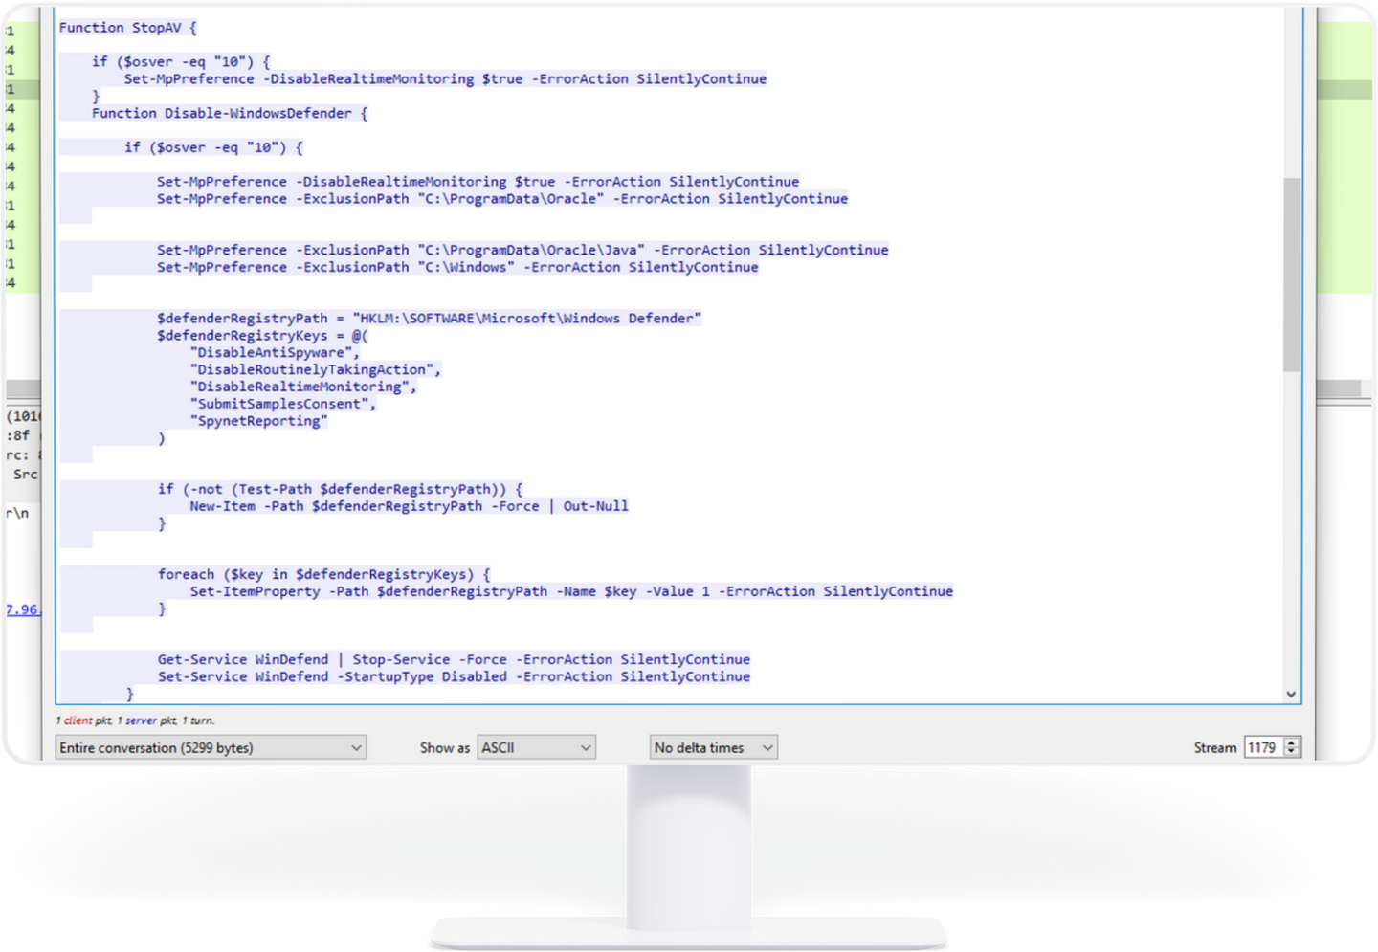
THE ATTACKER DISABLE WINDOWS DEFENDER

Slide 25
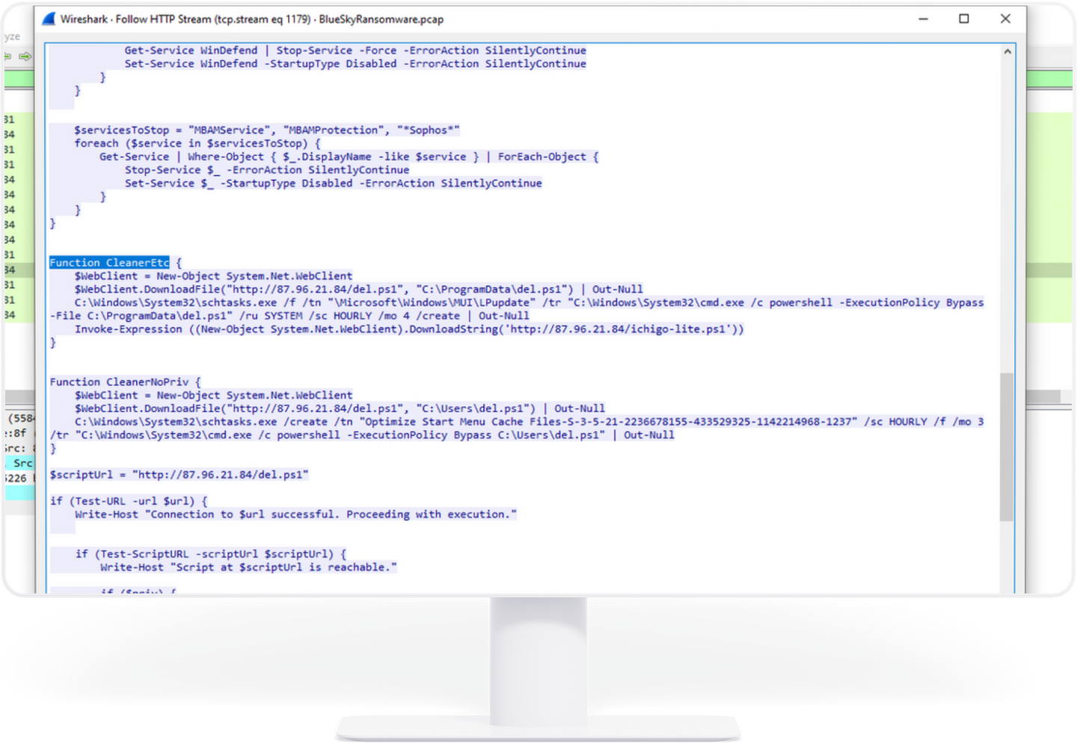
THE ATTACKER DOWNLOADS THE SECOND MALICIOUS FILE

Slide 26
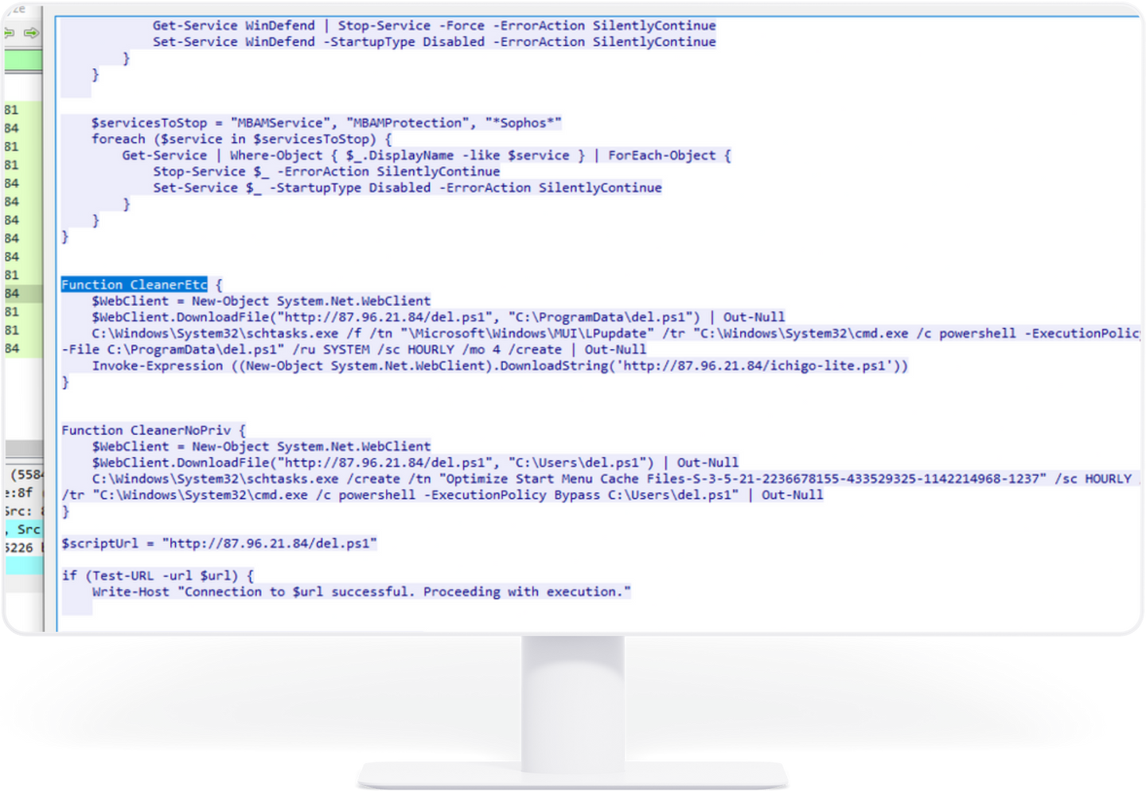
THE ATTACKER MAKES A TASK TO PERSISTENCE HIM

Slide 27
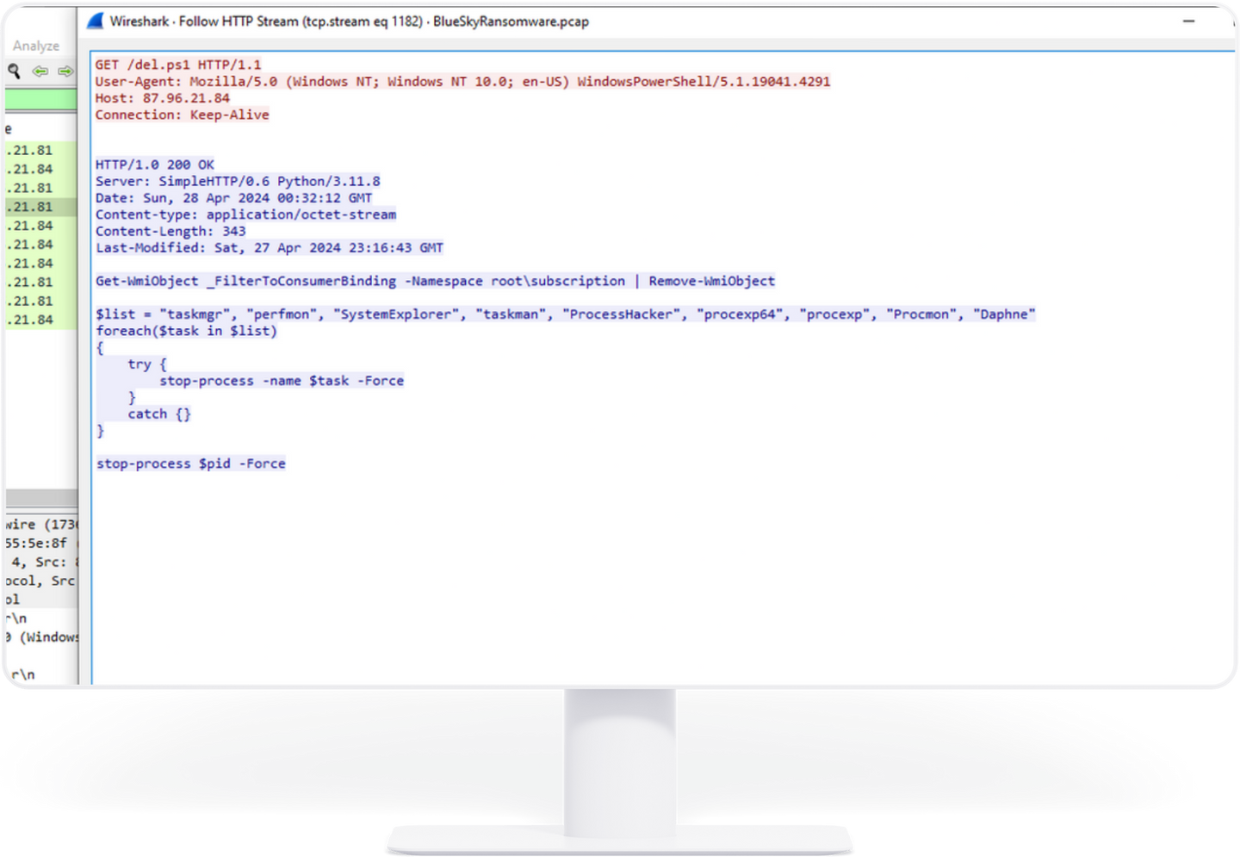
THE ATTACKER MAKES A TASK TO PERSISTENCE HIM

Slide 28
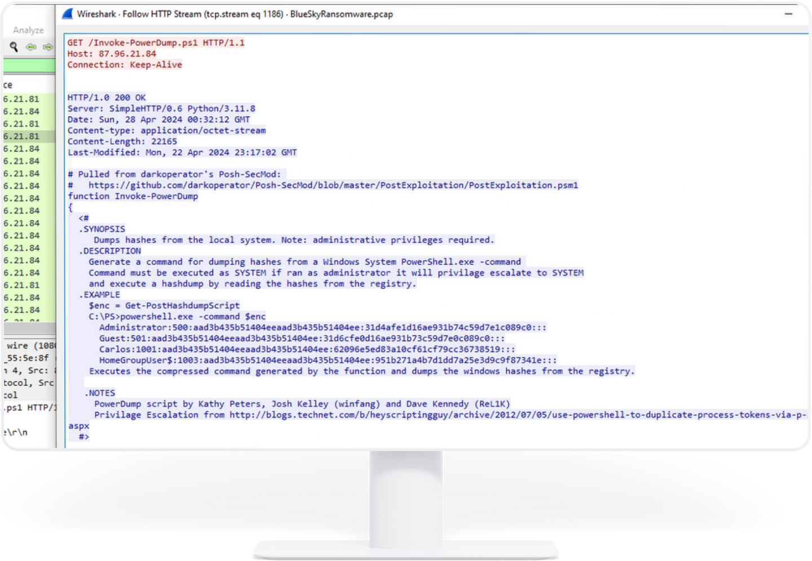
THE ATTACKER IS USING POWERSHELL TO DUMPING CREDENTIALS

Slide 29
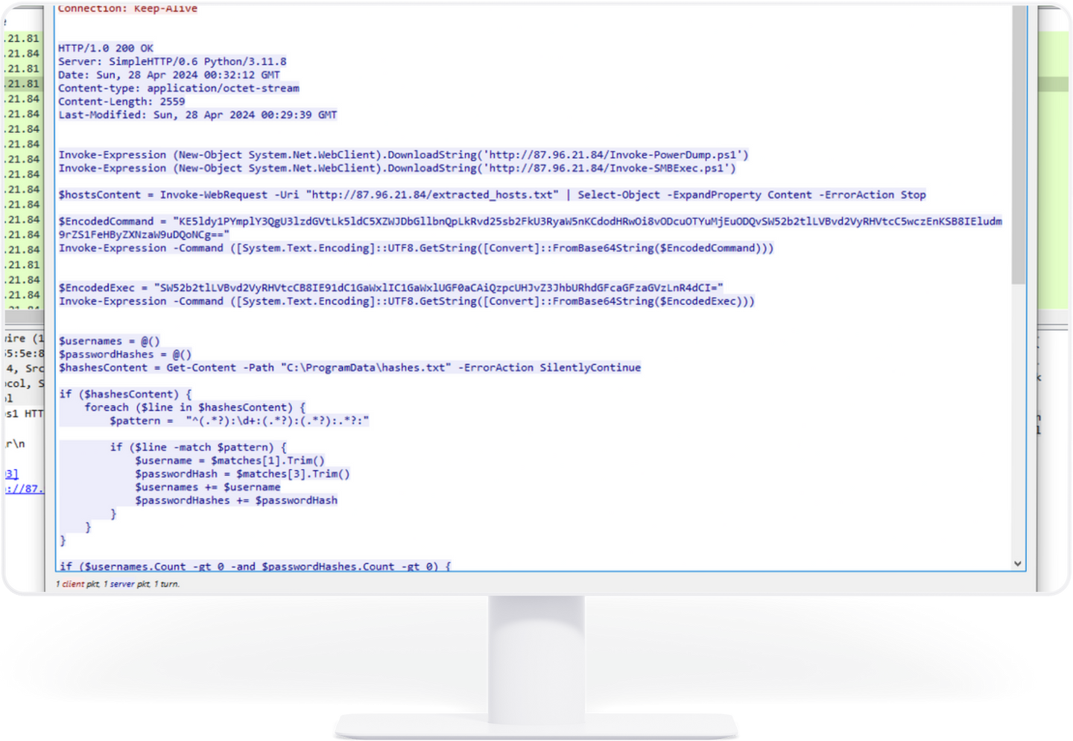
THE ATTACKER SAVED DUMPED CREDENTIALS IN A FILE

Slide 30
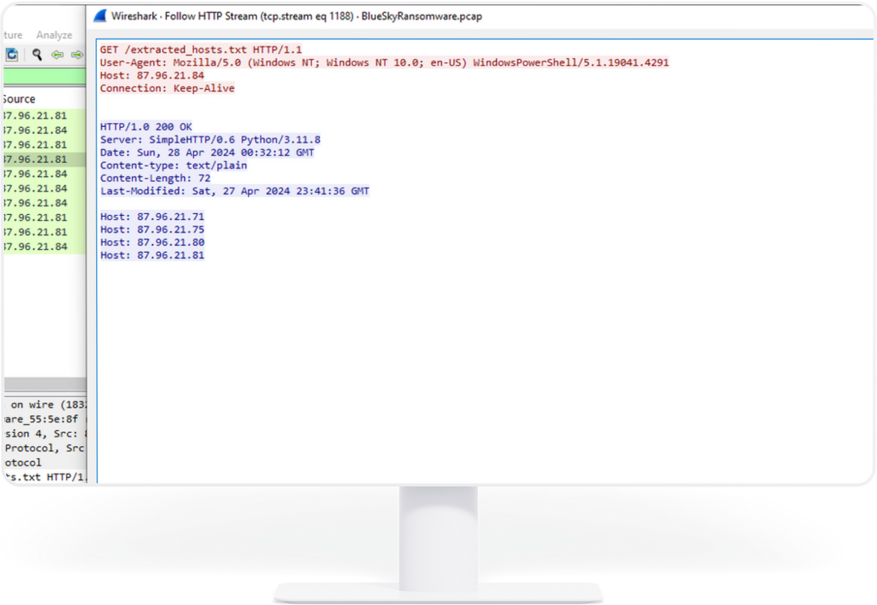
THE ATTACKER MAKES RECONNAISSANCE FOR THAT HOSTS

Slide 31
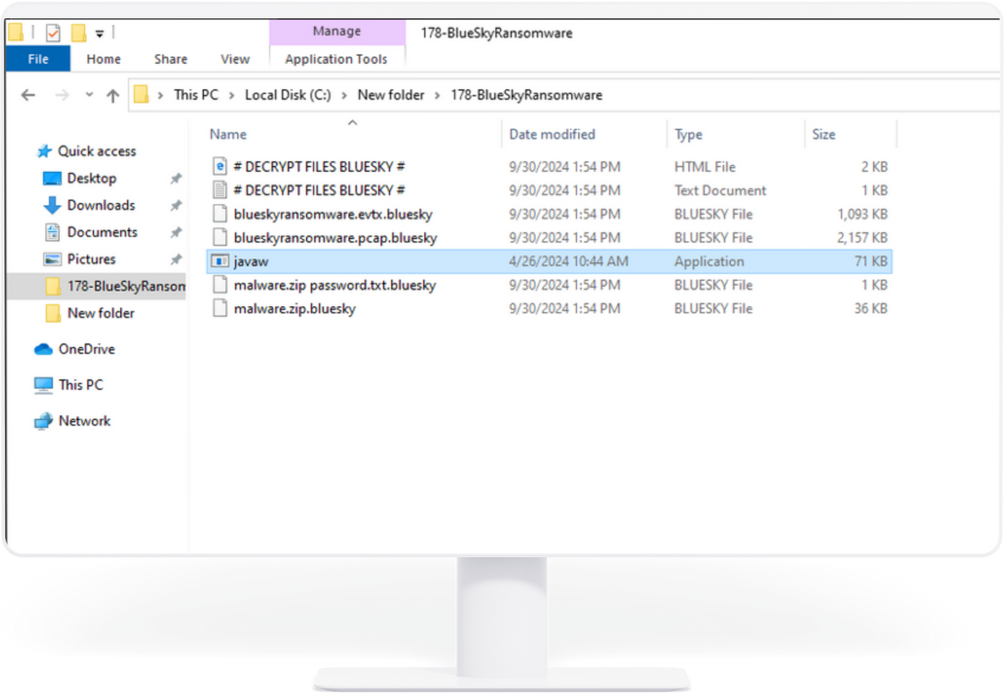
AFTER RANSOMWARE ACTIVE

Slide 32
KEY STRATEGIES

Slide 33
KEY STRATEGIES
Implement Advanced Threat Detection
Use machine learning and AI-driven tools.
Invest in Next-Generation Firewalls (NGFW) and Endpoint Detection and Response (EDR).
Backup and Recovery Solutions
Implement offline backups and cloud-based backups with multi-layer security.
Test your backup restoration process regularly.
Zero Trust Security Model
Implement a Zero Trust Architecture.
Monitor network activity to detect suspicious behavior.
Patch Management and Vulnerability Scanning
Automate software updates.
Regularly scan for vulnerabilities within your network.

Slide 34
ENHANCING EMPLOYEE AWARENESS
Security Training Programs
Ongoing training on how to spot phishing emails, social engineering attempts, and malicious attachments.
Phishing Simulations
Conduct regular phishing tests to evaluate employee awareness and response.
Multi-Factor Authentication (MFA)
Require MFA for all critical accounts to reduce the risk of unauthorized access due to stolen credentials.

Slide 35
INCIDENT RESPONSE PLAN

Slide 36
INCIDENT RESPONSE PLAN FOR RANSOMWARE
Preparation
Develop and continuously update an incident response plan tailored to ransomware attacks.
Detection and Identification
Use advanced monitoring tools to detect ransomware early.
Containment
Isolate infected systems quickly to prevent the ransomware from spreading.

Slide 37
INCIDENT RESPONSE PLAN FOR RANSOMWARE
Eradication and Recovery
Remove the ransomware and restore systems from backups.
Communication
Notify law enforcement and affected parties as required by regulations.
Post-Incident Review
Analyze the attack and strengthen defenses to prevent future incidents.

Slide 38
SUCCESS STORY

Slide 39
NORSK HYDRO
Industry: Aluminum Manufacturer
Challenge:
Norsk Hydro was hit by LockerGoga ransomware, which encrypted critical systems and disrupted operations globally, forcing some plants to revert to manual processes.
Response:
No ransom paid: The company refused to pay the ransom.
Backups: They relied on their strong backup systems to restore encrypted data.
Transparency: Norsk Hydro communicated openly with the public and stakeholders.
Outcome:
Though recovery costs reached $71 million, Norsk Hydro fully recovered without paying the ransom, setting an example for effective ransomware response and recovery.
Ransomware: LockerGoga

Slide 40
CONCLUSION

Slide 41
SUMMARY
Key Takeaways
Ransomware is a growing and evolving threat, but with the right defenses, preparation, and response plan, businesses can mitigate its impact.
Invest in advanced threat detection, employee awareness, and offline backups.
Regularly update and test your incident response plan to ensure it’s effective.
Call to Action
Review and strengthen your organization's defenses today. Ransomware prevention is a continuous process that requires proactive measures.

Slide 42
QUESTIONS
&
ANSWERS

Slide 43
THANK YOU!
FOR YOUR ATTENTION

Slide 44
I was created this presentation on Canva and you can facing some problems when you are using powerpoint,
for real presentation use link below,
For Live Preview In Canva Press This Canva:

